Slide 1

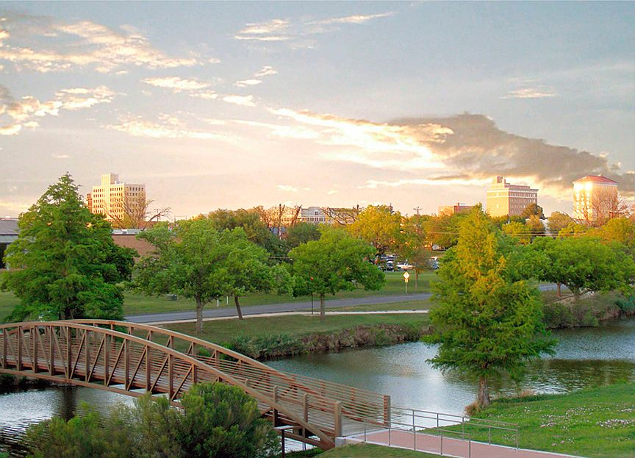
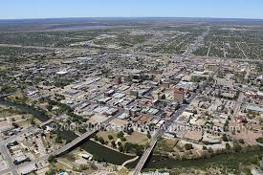
November 5th, 2013
City Council Meeting–Agenda Item 16
City of San Angelo
Solid Waste Services Contract for Waste Collection and Landfill Management

Slide 2
The Gregory Family, Acme Iron & Metal/Txalloy, Inc and Texas Disposal Systems (TDS) Partial History and Overview Related to Servicing the San Angelo Contract:
  1951 – Acme Iron & Metal Co. founded in San Angelo by James Gregory. A scrap metal processing facility, which has served the San Angelo community as the area’s largest recycler for 62 years, and is now operated by Txalloy, Inc, owned by Bob Gregory, now processing 40,000 tons/year.
  1972 – Texas Alloys founded in San Angelo by Bob Gregory. A scrap electronics recycling facility, which was later incorporated as Txalloy, Inc. and purchased Acme Iron & Metal from James Gregory in 1984.
  1977 – Texas Disposal Systems, Inc. (TDS) founded in Austin by Bob and Jim Gregory.
  1990 – TDS was granted the state’s first ever fully integrated permit for landfill, recycling and compost operations, with the intent to divert as much material from disposal as economically possible.
  1995 – TDS was awarded a 30 year contract with the City of San Antonio for transfer station operations and landfill disposal.
  2000 – TDS was awarded a 30 year contract with the City of Austin for landfill disposal with a minimum of 66% of the City’s solid waste and other services.
  2001 – TDS purchased Garden-Ville, a compost production company now with 7 gardening product retail sales outlets.
TDS History and Overview

Slide 3
Partial History and Overview (cont’d):
  2007 – TDS awarded City of Alpine waste collection and landfill operating contract, extended by 10 years in 2012, with a scrap metal, cardboard, brush, wood and glass recycling program.
  2008 – TDS received the Gold Award from SWANA, as the best landfill in North America.
  2010 – TDS opened its Materials Recovery Facility (MRF) in 2010 with a 2 year contract for 100% of Austin’s single stream recyclables. Now a 20 year contract with a minimum of 24,000 tons/year.
  2013 – Sept 1st – Awarded contract by Angelo State University for collection of solid waste and recyclables.
  2013 – Nov 4th– Mertzon City Council voted to negotiate an exclusive contract with TDS for both residential and commercial waste collection and disposal.
  .
TDS History and Overview

Slide 4
TDS is an integrated company with 13 interdependent business units
  TDS services 100+ municipalities, HOA’s and MUD’s, including large collection service contracts for Georgetown, Buda, Kyle, San Marcos, Weimar, Sealy, Alpine and others.
  100% of the City of Austin collected residential solid waste (175,000+ homes) is disposed at TDS landfill under a 30 year contract.
  33% of the City of San Antonio collected residential solid waste is transferred through a TDS operated facility in San Antonio and disposed at TDS landfill (approximately 100,000 tons/year) under a 30 year contract.
  40% of City of Austin collected Single Stream recyclables is processed at the TDS MRF (minimum of 24,000 tons/year) under a 20 year contract.
  TDS processes Single Stream recyclables and yard/wood waste for thousands of other customers through out central Texas.
  TDS services the City of Alpine for waste collection, limited recycling and landfill operation.
  TDS operates four City-owned transfer stations in Sealy, San Antonio, Weimar and Georgetown.
  Approximately 20% of the tons received at the TDS facility are diverted from landfill disposal, due to our commitment to diversion practices.
  TDS landfill receives between 2,000 and 3,000 tons per day.
  In 2012 TDS diverted 137,000 tons at the Austin landfill, composting and recycling facility through diversion practices (in comparison, the City of San Angelo landfill diverted 244 tons in 2012).
  TDS maintains a fleet of 200+ trucks and 600 employees.
TDS History and Overview

Slide 5
Current Contract Operator
No apparent commitment to reduce the consumption of landfill capacity, because that may not fit their regional landfill business model for the contract.
Very little landfill diversion has been done through recycling and composting at the San Angelo landfill (According to the last 10 years of San Angelo’s Annual Landfill TCEQ reports, the current diversion rate is less than 1%).
The remaining life of the landfill is decreasing rapidly due to a combination of poor compaction of waste into the landfill, minimal landfill diversion of things that can be recycled and composted, and much more waste coming in from outside of San Angelo (50% of total).
With expected oil and gas development activity expansion, landfill space consumption may significantly increase.
At this rate of increased landfill space consumption, the City landfill capacity could be consumed within 5 years.
City of San Angelo Landfill Summary from City Annual TCEQ Reports
 | Total | Diversion | Compaction | Years Life
Year | Tons Buried | Tonnage | Rate | Remaining
2003 | 112,197 | 1,541 | 1000 lbs/cyd | 41
2004 | 98,228 | 1,773 | 1000 lb/ cyd | 34
2005 | 138,684 | 1,302 | 1150 lbs/cyd | 32
2006 | 125,728 | 694 | 1150 lbs/cyd | 34
2007 | 137,886 | 337 | 1150 lbs/cyd | 30
2008 | 152,691 | 544 | 1150 lbs/cyd | 24
2009 | 141,290 | 199 | 1150 lbs/cyd | 26
2010 | 137,256 | 1,225 | 1000 lbs/cyd | 22
2011 | 146,612 | 2,295 | 826 lbs/cyd | 17.2
2012 | 171,508 | 244 | 826 lbs/cyd | 13
Total | 1,362,080 | 10,154
avg/yr | 136,208 | 1,015
% diversion |  | 0.75%
San Angelo Landfill – Remaining Life of Landfill

Slide 6
In 1993, the approval of RCRA Subtitle D prompted cities to close smaller landfills. This made the remaining landfills regional landfills.
Currently, we understand that the solid waste from approximately 25 municipalities is being disposed in the San Angelo landfill. The City’s budget shows that the landfill is not profitable for the City and is not generating adequate revenues to pay for the City’s future financial landfill obligations.
According to the City budget for 2013, the landfill is budgeted to break even and not add revenues to the Solid Waste Enterprise Fund.
We believe the City of San Angelo needs to generate landfill revenues to pay for the future operation, permit maintenance, expansion, closure, post closure cost and mitigation obligations, and to have a return on its risk and investment.
The continued extension of the Trash Away/Republic contract has resulted in the City’s landfill becoming a major liability for the City, which needs to be managed as a profit center for the City, fully capable of covering 125% of its operations, future expansion and remediation expenses. Under a dramatically different contract, the landfill could be a major asset for the City.
TDS has the experience and the resources available to permit a new or expanded landfill near San Angelo and purchase all necessary trucks, containers and equipment for the task.
San Angelo Landfill – Regional Benefits

Slide 7
Landfill Closure and Post Closure
What is the City’s estimate for the funds needed for the closure and post closure and remediation of the City landfill, as currently permitted? And how much does the City now have set aside?
Current landfill life was estimated at the end of August 2012 at 13 years; ten years ago, staff estimated a remaining life of 41 years.
Under the Republic/Trash Away management of the City’s landfill as its regional landfill, the City has lost an average of 2.8 years of landfill life annually over the last 10 years. If this rate of increased waste intake continues, the City landfill could be filled within the next 5 years.
An Existing Landfill Expansion or a New Landfill
What is the estimated cost for future permitting to expand the landfill and/or to permit a new landfill, and how will the City pay for it?
Will the City Council continue a 5 year term on its waste collection and landfill operations contract with no responsibility on its contractor to help the City amend the existing City landfill permit for an extension of the operating life of the landfill? Or, will the City Council direct staff to seek proposals through an RFP process to manage the City owned landfill under a life-of-site long term contract that requires the contractor to help the City expand the landfill through a permit amendment, or to permit a new landfill on land the City currently owns across the street from the existing landfill?
Things to Consider for New Contract

Slide 8
In San Angelo, TDS would like to present an RFP response for:
  Residential and commercial solid waste collection and Single Stream recycling with several options, including one that does not increase the current residential rate.
  Single Stream recycling options for all Residents and Commercial businesses.
  Increased revenue stream for the City by significantly altering the landfill management section of the contract.
  Increased efficiencies in the design and management of the City landfill to extend the life of the landfill and the addition of an on-site composting and recycling operation.
  Establishing school recycling and school food-waste composting programs, and an education program for residential and business participants.
  Job creation – hiring local drivers and support employees, including drivers and maintenance personnel potentially displaced by a change of the contractors.
  Potential long term lease of the City’s landfill.
  TDS will support local economy by buying locally, as Acme Iron & Metal/Txalloy, Inc. has done for 62 years.
  .
  TDS will establish a stand alone office, maintenance and equipment storage facility, and would like to have a grinding and compost operation on the landfill site.
TDS Plan for San Angelo

Slide 9
TDS will work with local recycling facility, Butts Recycling, on what they can handle and, as necessary, will bring the remaining recyclables to the TDS MRF in Austin, until a MRF is justified in San Angelo.
Single Stream recycling option items will include:
Paper
Cardboard/Boxboard
Plastic Containers (1-7)
Metal Items
Aluminum and Steel cans
Glass Containers (potentially- City choice)
Gable Top Containers (potentially- City choice)
Aseptic Containers (potentially- City choice)
Bagged Film Plastics (potentially- City choice)
Single Stream Recycling

Slide 10
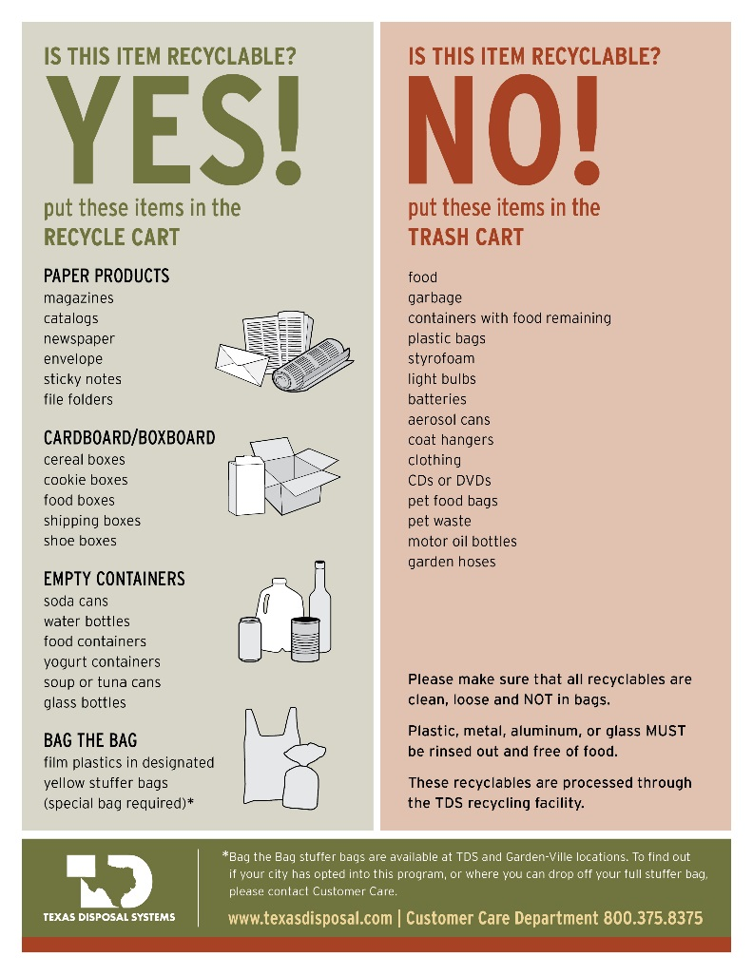

Slide 11

  TDS Catastrophe Response
  Utilize assets company-wide to respond to any catastrophe in San Angelo
  Utilize TDS owned transfer trucks to transfer large amounts of material
  Utilize TDS owned industrial equipment such as, loaders, grinders, end dumps, cranes
  Utilize existing large equipment rental relationships
  Utilize equipment from Acme Iron & Metal in San Angelo
  TDS has a proven record of large scale emergency response and has the commitment, determination and financial resources to meet the City’s needs.
  TDS recommends that a catastrophe plan be required in RFP responses
TDS Catastrophe Plan

Slide 12
TDS requests that for the first time in approximately 40 years, the City Council seek and accept competitive proposals for the City’s solid waste services contract:
Define the type of collection service the council would like to receive and whether to consider curbside Single Stream recycling.
Decide whether the council would like the landfill management portion of the contract to remain as it is, or to require the contractor to help the staff expand the existing landfill or help the staff permit a new landfill across the street.
Consider what level of revenue the City Council believes the landfill needs to generate in order to fund future obligations for operation, expansion, closure, post closure and remediation of the existing landfill and the permitting for the new or expanded landfill.
Weigh the financial benefits to the City to continue to contract with an operator of the landfill or enter into a long term lease of the landfill.
Consider the benefits of an educational program provided by the contractor to promote programs as determined by the City Council.
Issue a Request For Proposal for the management and expansion of the landfill, and servicing the Residential and Commercial businesses in the City.
Determine the best course of action for the City from the RFP response options presented and from staff recommendations.
Don’t be discouraged by Republic representative’s claims that TDS will not be able to adequately respond to a disaster, will not have the resources to purchase the necessary equipment, or help the City with the permitting needs of the landfill, or that TDS personnel do not know how to professionally manage a landfill, build a hauling operation, or service a major contract. TDS has proven its worth many times before and will again in San Angelo, if the Council will just give us the opportunity. Our reputation speaks for itself.
TDS Requests

Slide 13
Time is of The Essence
The current San Angelo waste collection and landfill management contract expires July 31, 2014.
November 2013 City Council votes for San Angelo Staff to write RFP
December 2013 RFP circulates through legal approval process of the City
January 2014 RFP is issued and proposers respond
February 2014 RFP responses submitted and staff evaluates responses
March 2014 Council votes on a contract award
April 2014 Purchase of trucks, containers, and equipment to service contract
July 31, 2014 Begin servicing City with all containers/equipment in place
A Reasonable Timeline

Slide 14
Depending upon how the City calculates this contract’s annual gross revenue value and the contractor’s financial benefit of using the City landfill, we believe the value of this contract is between $15 million and $30 million.
TDS sales representatives are now calling on customers and have found rates for residential solid waste collection services outside the incorporated limits of the City of San Angelo to range from $25.00 to $130.00 per month, with many in the $70.00 per month range. This shows a serious need for competition within the market. There are also very few options for recycling.
To our knowledge, over the past 40 years, the City’s solid waste services contract has never been put out for a competitive bid or subject to a Request For Proposal (RFP). Please allow TDS the opportunity to submit an RFP response to provide the City with options to collect its solid waste, collect its designated types of recyclables, and to manage the City’s landfill, composting and recycling operations.
TDS urges the City Council to competitively bid this contract and to approve an RFP process soon, to allow time for the necessary review, approval and startup steps to occur.
There will still be time for the Council to negotiate with Republic, if the Council chooses to not do an award consistent with an RFP response.
The City has nothing to lose, and much to gain by allowing an RFP process.
Thank you for the opportunity to be of service to the City of San Angelo
The Need For An RFP Process Before Negotiations

Slide 15
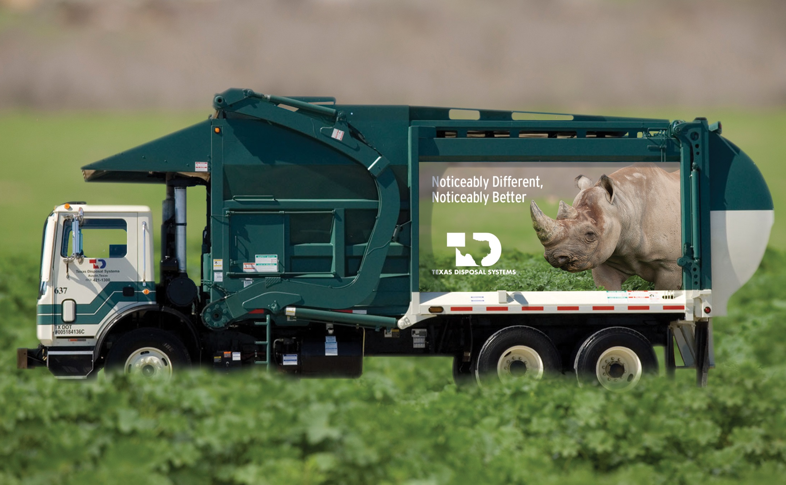
TDS- Noticeably Different, Noticeably Better

